Slide 1


Project 3
Devin Fogerty
Demiko Birden
Corey Zwister
Irfan Ghaffar

Slide 2
Influenza Visualization
Want to visualize the Influenza map of the US States
We will use minimum of three forms of visualization
Bar Chart
Pie Chart
Line Chart
Visualize:
Flu variation by season
Strain most dominant
States with most confirmed cases relative to population
Effect of coronavirus lockdowns on influenza rates

Slide 3
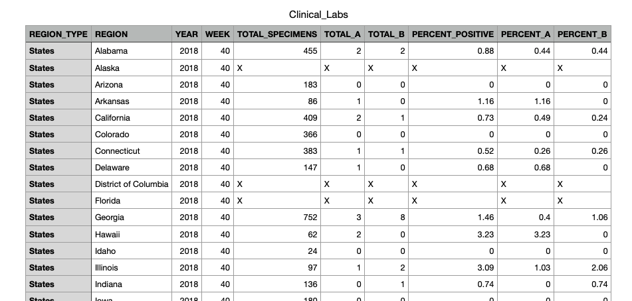
Data
Data extracted from the CDC website.
Data from the past five years.
All the data were in csv files

Slide 4
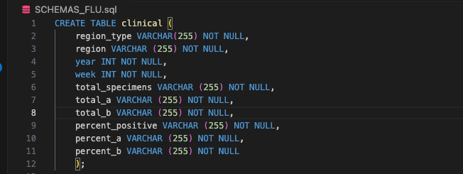
Data Cleanup
SQL used to make tables and import data

Slide 5
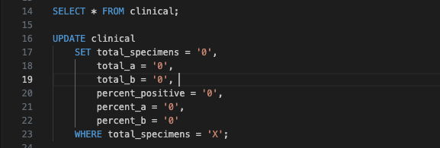
Cleaned up the data using SQL as well
”x’s” were switched to zeros
Removed data for non-states like Puerto Rico, Guam, and the Virgin Islands

Slide 6
Dashboard Visualization
Extract data to JavaScript
Write JavaScript code to create Dashboard for Visualization
Live and user interactive Dashboard
Filterable by Years and States
Dashboard includes
Line Chart
Pie Chart
Bar Chart

Slide 7
Any Questions?

Slide 8
Thank you!

